Slide 1
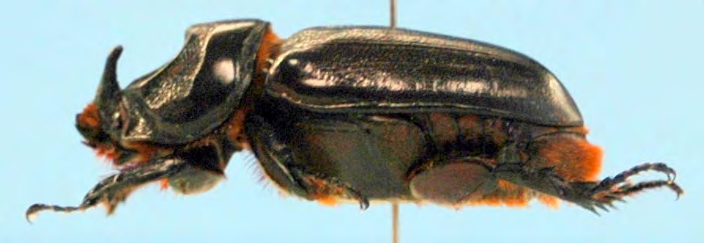


Status of a Major Outbreak of Coconut Rhinoceros Beetle, Oryctes rhinoceros Biotype G, on Guam and Attempts at Establishing Biological Control
Aubrey Moore
James J. Grasela
XIX International Plant Protection Congress
Hyderabad, India
11 November 2019
Sean D. G. Marshall

Slide 2




Thanks for support and funding from:
US Dept of Agriculture
Animal Plant Inspection Service
US Dept of Agriculture
Forest Service
Legislature of Guam
US Dept of the Interior
Office of Insular Affairs
Notes:
Add DOI-OIA

Slide 3
Outline
Introduction
CRB Invasion History
CRB Population Dynamics
Recent CRB Activity on Guam
Biological Control
Damage Survey
Online Resources

Slide 4
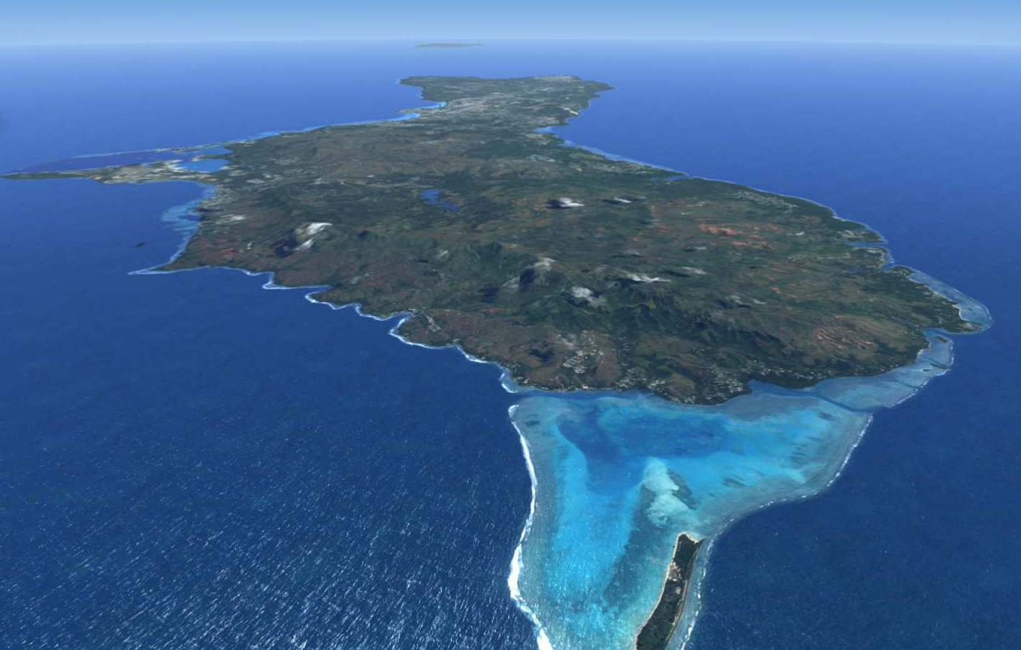
Guam

Slide 5
Notes:
This is the first CRB collected on Guam
Sept. 11, 2007

Slide 6
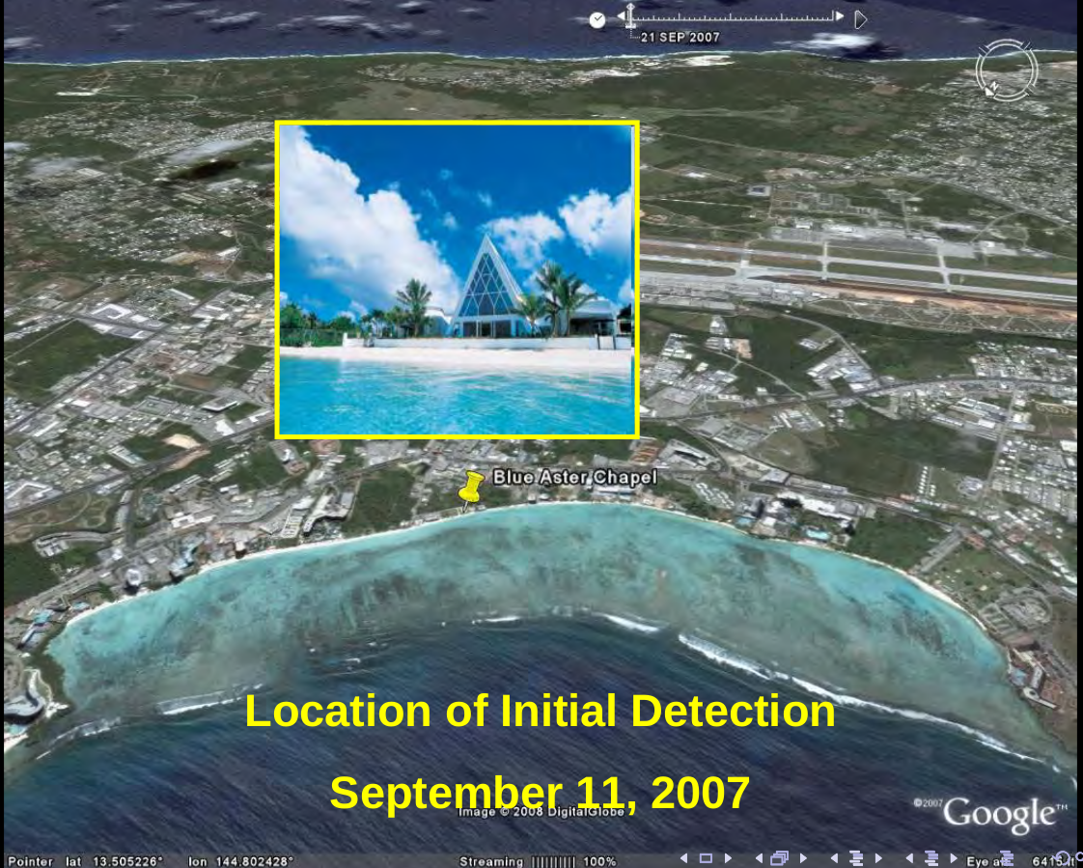

Slide 7
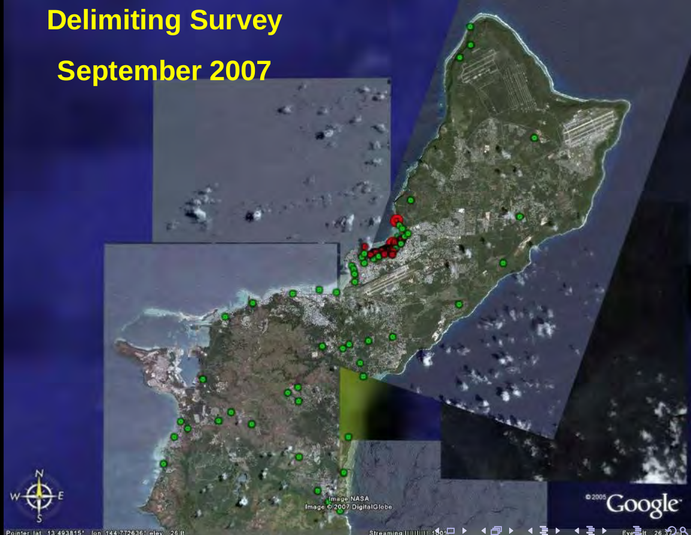
Notes:
A delimiting survey indicated that CRB had invaded only a small area of Guam (Tumon Bay and Fafai Beach).
Based on this information, an eradication program was launched.

Slide 8
How to Eradicate CRB
Sanitation: Locate and destroy all active and potential breeding sites.
Quarantine: Close pathways to prevent re-introduction and accidental transport to uninfested areas.
Note: Only one of many CRB eradication programs has succeeded (Niuatoputapu Is., aka Keppel Is., Tonga; 16 km² ).

Slide 9
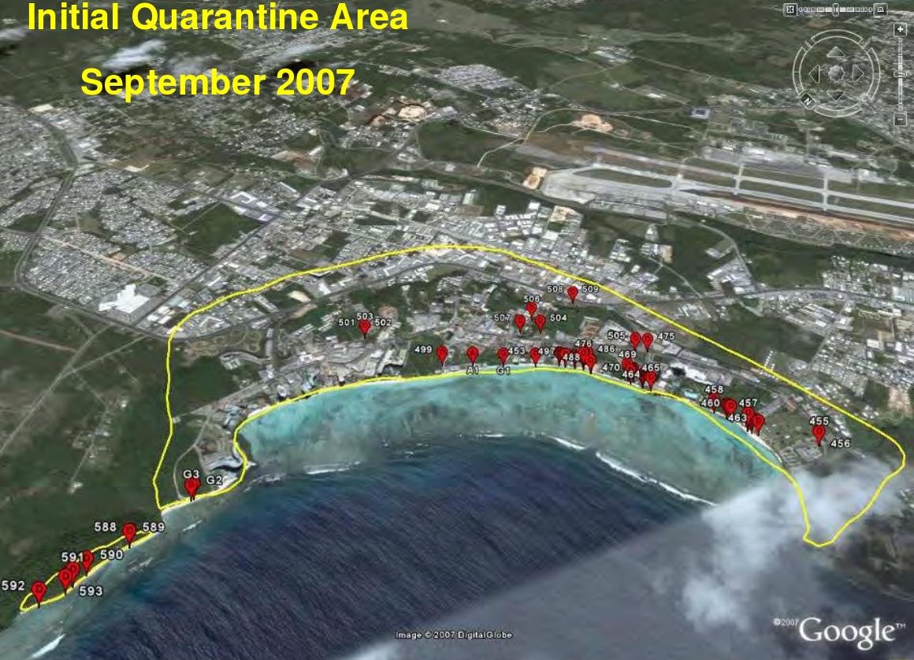

Slide 10
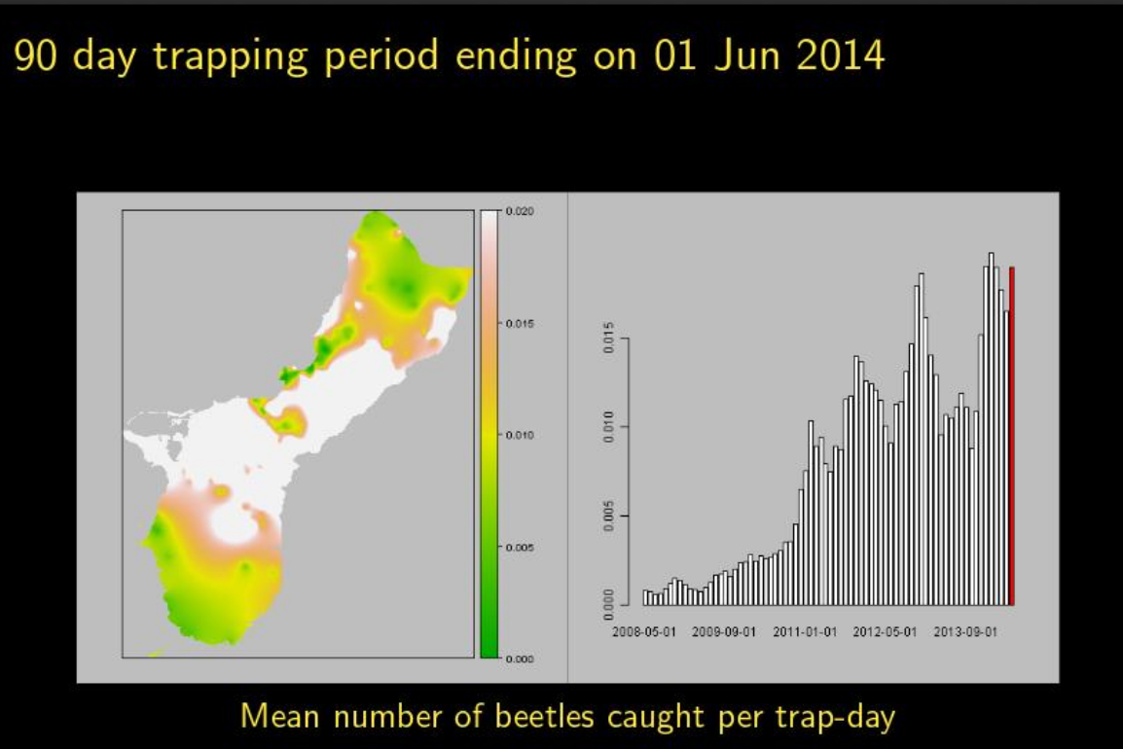
Guam Pheromone Trap Catch Data
Screen capture from https://www.youtube.com/watch?v=DtBkEOsdGRE

Slide 11
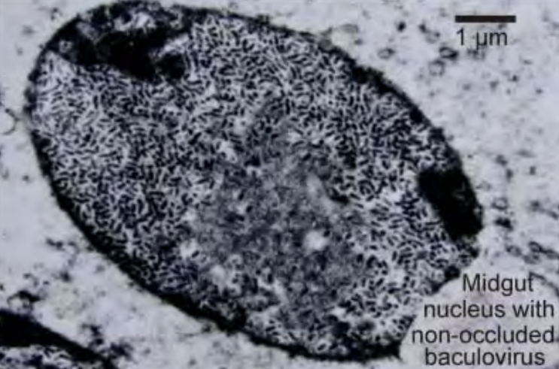
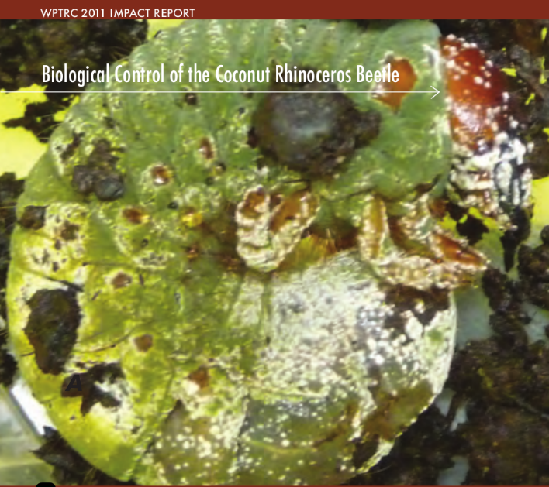
Biocontrol
Oryctes rhinoceros nudivirus (OrNV)
Green muscardine fungus (GMF)
Metarhizium majus
Notes:
There are few effective biocontrol agents for CRB.
OrNV is the preferred BC agent. Unfortunately the Guam CRB population is apparently resistant to all available isolates.
GMF is usually used as a biological insecticide. It has been successfully established on Guam as a classical BC agent. Based on 21 day mortality data for 1,466 CRB collected from 75
sample sites, it is estimated that between 10% and 38% are being killed by GMF infection.

Slide 12
Discovery of the CRB-G Biotype
Marshall, S. D. G., Moore, A., Vaqalo, M., Noble, A., & Jackson, T. A. (2017).
A new haplotype of the coconut rhinoceros beetle, Oryctes rhinoceros, has escaped biological control by Oryctes rhinoceros nudivirus and is invading Pacific Islands.
Journal of Invertebrate Pathology, 149, 127–134. https://doi.org/10.1016/j.jip.2017.07.006

Slide 13
Characteristics of CRB-G
genetically distinct
resistant to all available isolates of OrNV
behavioral differences ???
not highly attracted to oryctalure
higher per-capita damage

Slide 14
Outline
Introduction
CRB Invasion History
CRB Population Dynamics
Recent CRB Activity on Guam
Biological Control
Damage Survey
Online Resources

Slide 15
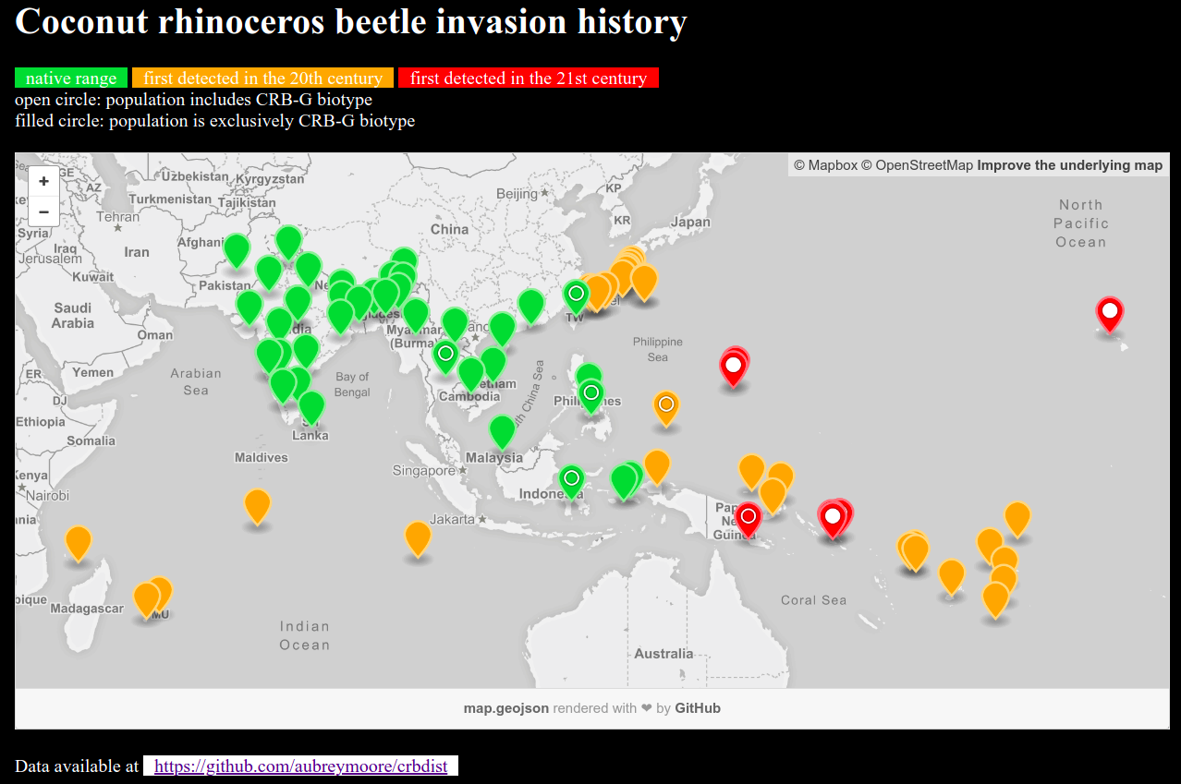
Screen capture from http://aubreymoore.github.io/crbdist/mymap.html 2018-08-05

Slide 16
Outline
Introduction
CRB Invasion History
CRB Population Dynamics
Recent CRB Activity on Guam
Biological Control
Damage Survey
Online Resources

Slide 17
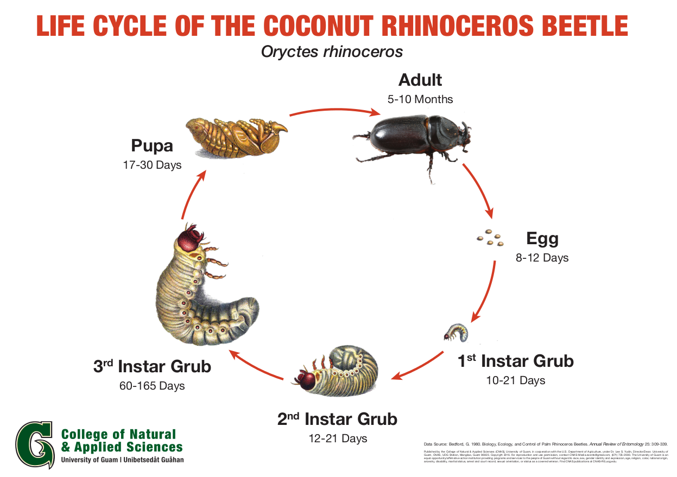
100 eggs per female
Notes:
Generation time: 6 to 9 months
Female lays about 100 eggs (biotic potential of 50
which equals an increase of 5000% per generation)
Only adults do damage.

Slide 18
CRB Population Growth May Be Explosive
Generation | Number of Beetles
0 | 2
1 | 100
2 | 5,000
3 | 250,000
4 | 12,500,000
5 | 625,000,000
6 | 31,250,000,000
7 | 1,562,500,000,000
8 | 78,125,000,000,000

Slide 19
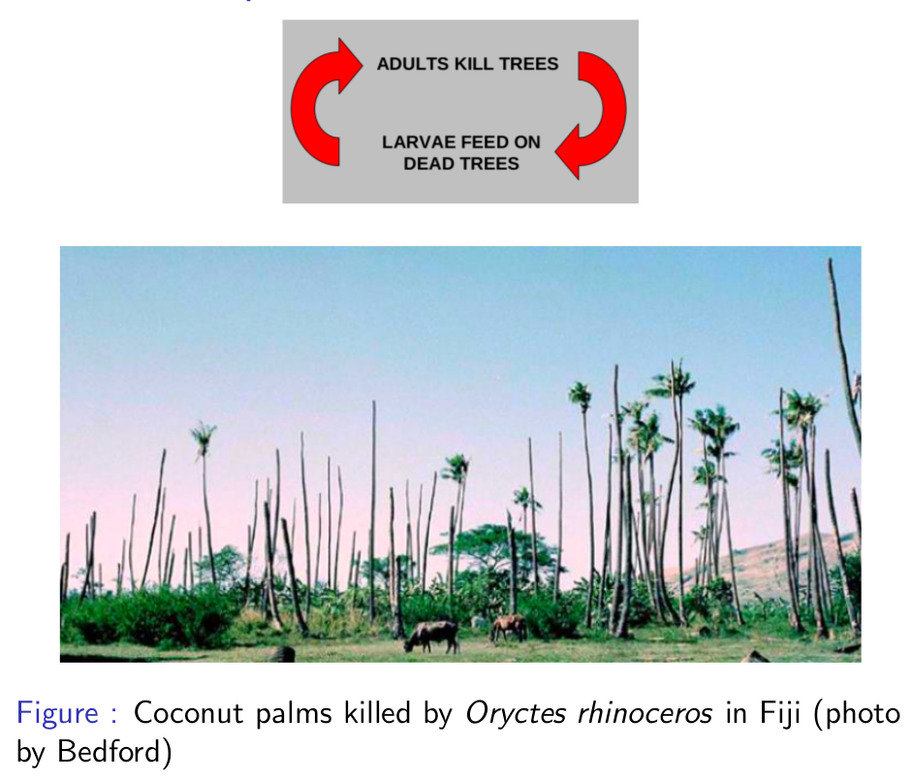
Notes:
Palms killed by adults become preferred breeding sites which generate several generations of grubs.
If CRB adults are abundant, many palms will be killed creating breeding sites which generate even more adults.
This positive feedback cycle may not stop until CRB run out of food after killing most palms.

Slide 20
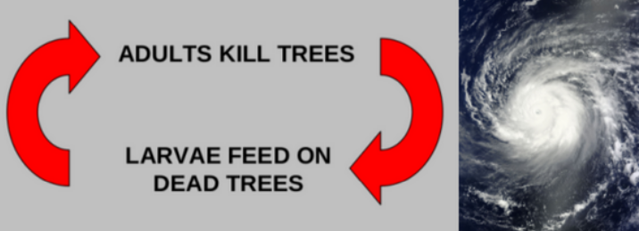
The current outbreak was triggered by Typhoon Dolphin which visited Guam in May 2015. Adult CRB emerging from abundant breeding sites where numerous to start killing mature coconut palms.
Dead standing coconuts are now generating further generations of CRB which are killing even more palms.

Slide 21
Outline
Introduction
CRB Invasion History
CRB Population Dynamics
Recent CRB Activity on Guam
Biological Control
Damage Survey
Online Resources

Slide 22
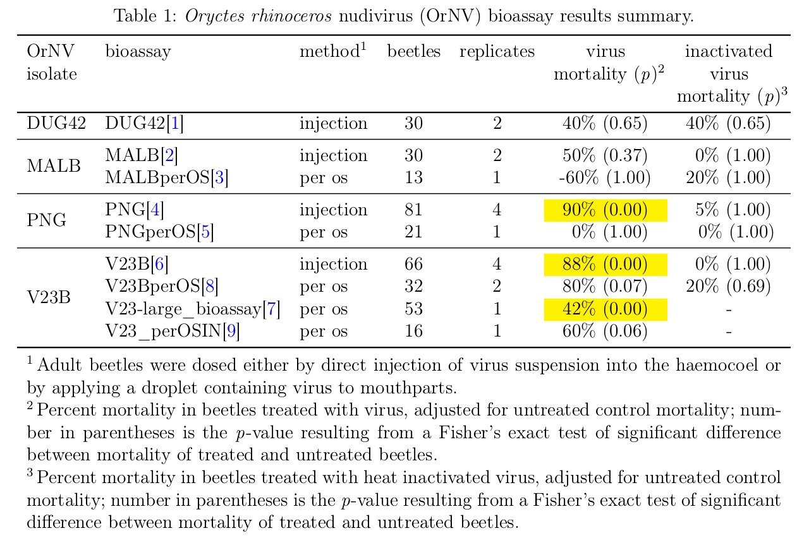
Recent OrNV / CRB-G Bioassay Results

Slide 23
Outline
Introduction
CRB Invasion History
CRB Population Dynamics
Recent CRB Activity on Guam
Biological Control
Damage Survey
Online Resources

Slide 24
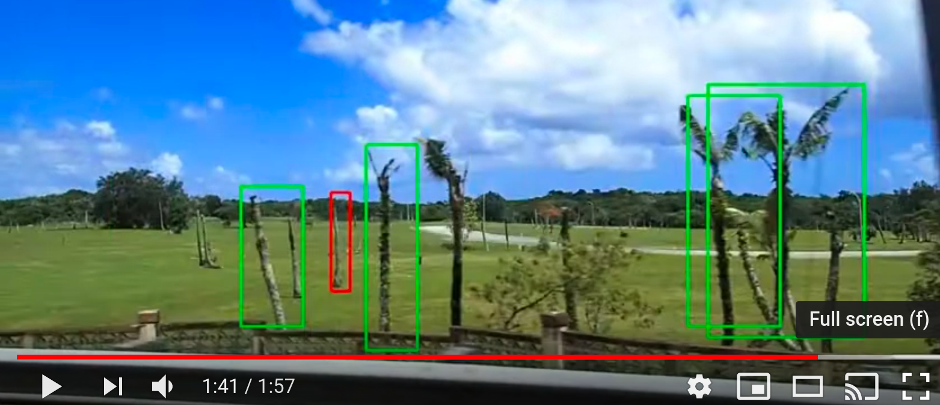
Automated Mapping of CRB Damage from Roadside Video Surveys
Screen capture from https://www.youtube.com/watch?v=zzSorqcmt9U 2019-11-04

Slide 25
Outline
Introduction
CRB Invasion History
CRB Population Dynamics
Recent CRB Activity on Guam
Biological Control
Damage Survey
Online Resources

Slide 26
Online Resources
CRB Bibliography https://github.com/aubreymoore/CRB-Bibliography
Interactive CRB Invasion History Map http://aubreymoore.github.io/crbdist/mymap.html
CRB Wiki Site http://guaminsects.net/CRBG/index.phptitle=CRB-G_Wiki
CRB-G Facebook Site https://www.facebook.com/groups/crbg07/

Slide 27
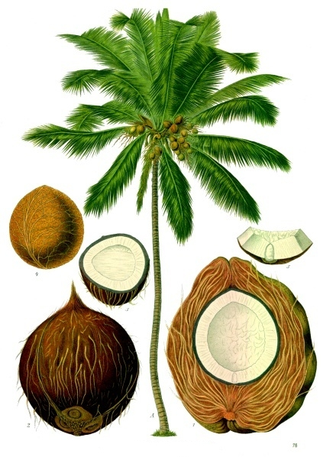
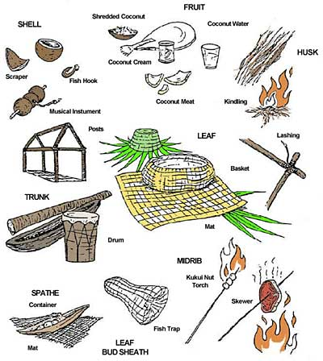
Notes:
Loss of coconuts on smaller islands and atolls where people rely on coconut as the “tree of life” will be a human disaster.

